Slide 1
Everything You Need is There
Taslim Jay Dosunmu

Slide 2
Who Am I?
And Why Should You Listen to Me?
Notes:
- School
- Work
- Opportunities

Slide 3
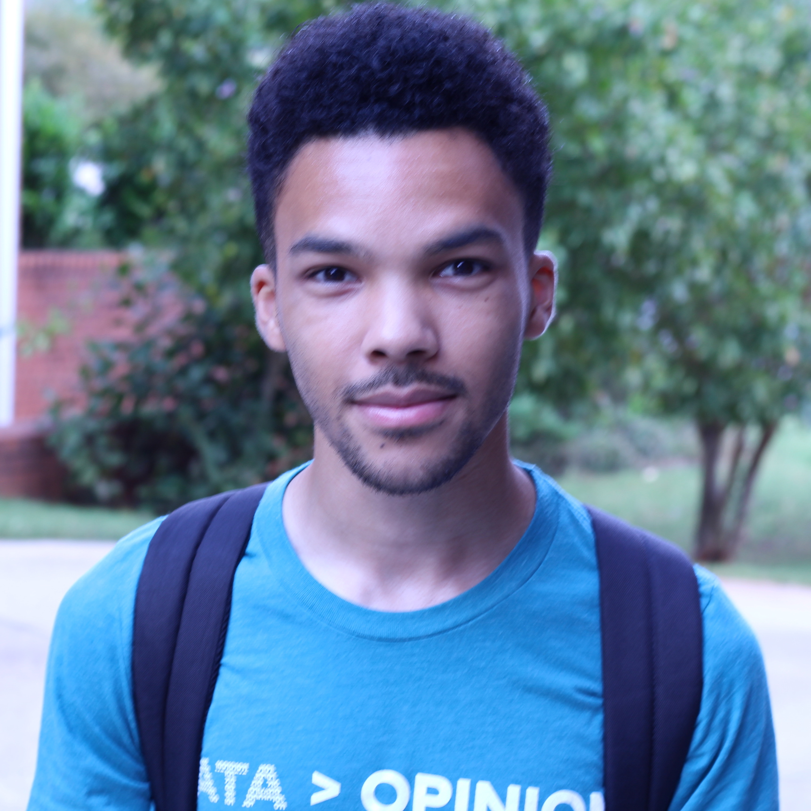




CS Bachelor’s
Senior (Dec 2019)
Notes:
About me
Finishing senior year of CS Major at Georgia State University
A side project I built over my Thanksgiving break using tools from the Student Developer Pack has helped almost 1000 students, has been featured by Github Education, and helped me get my first job
Worked in several opportunities including:
Data Science internship within enterprise business role at Stanley Black and Decker
Co-oped at Georgia Tech Research Institute, working on a high profile project at Georgia Tech where I did devops stuff, analytics, and android software development
Interned at SurveyMonkey as a Machine-Learning Engineer. My work was involved in the recent launch of Sentiment Analysis on the platform. Most notably, they kept me on part time working remotely when my internship was completed— which is dope.
Reason for sharing: “Only partially to flex, it’s really to give merit to what I’m about to share”

Slide 4
Quick Survey
Before We Get Started
Notes:
- Who is interested in getting an internship or full-time role this Summer or next Summer, or some time in between?
- Who is either starting their first opportunity or beginning another one this Summer?
Those who haven’t found an opportunity yet, look at the people who have their hand up. I would recommend maybe asking for advice on getting one (without being annoying)
- Who was unable to get an internship opportunity this Summer?
Those who have or had opportunities, take a look around. I challenge you to connect with one of these people and mentor them (with their consent, of course)

Slide 5
Main Sections
Seeking Opportunities
Making the Most of Opportunities
Mentoring

Slide 6
Seeking Opportunities
Be Prepared for Anything
Notes:
Having something to show
Athena Jumpstarting my career
Be open to unexpected opportunities

Slide 7
Have Something to Show
Make use of available resources (Student Developer Pack)
Get comfortable with tools of the trade (Student Developer Pack!)
Take advantage of Open-Source everything (Github!!)
Great way to develop engineering and teamwork skills

Slide 8
Athena Jumpstarting my Career
Side project developed over Thanksgiving break
Solved a problem I recognized
Great way to learn new things

Slide 9
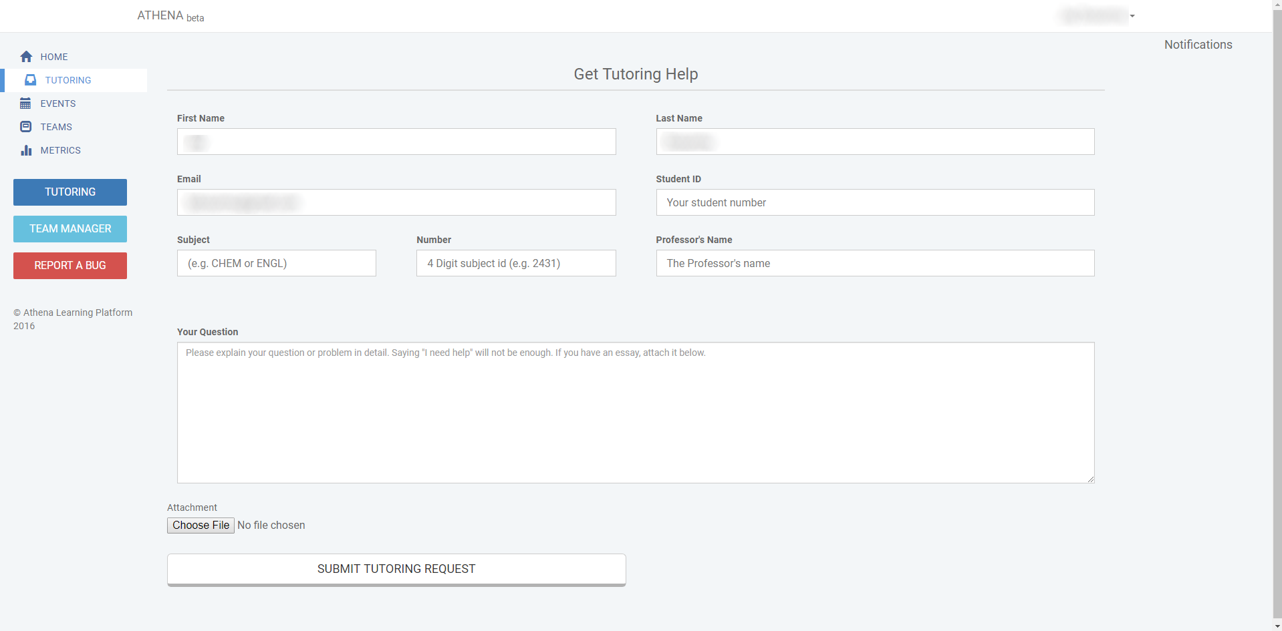

Slide 10
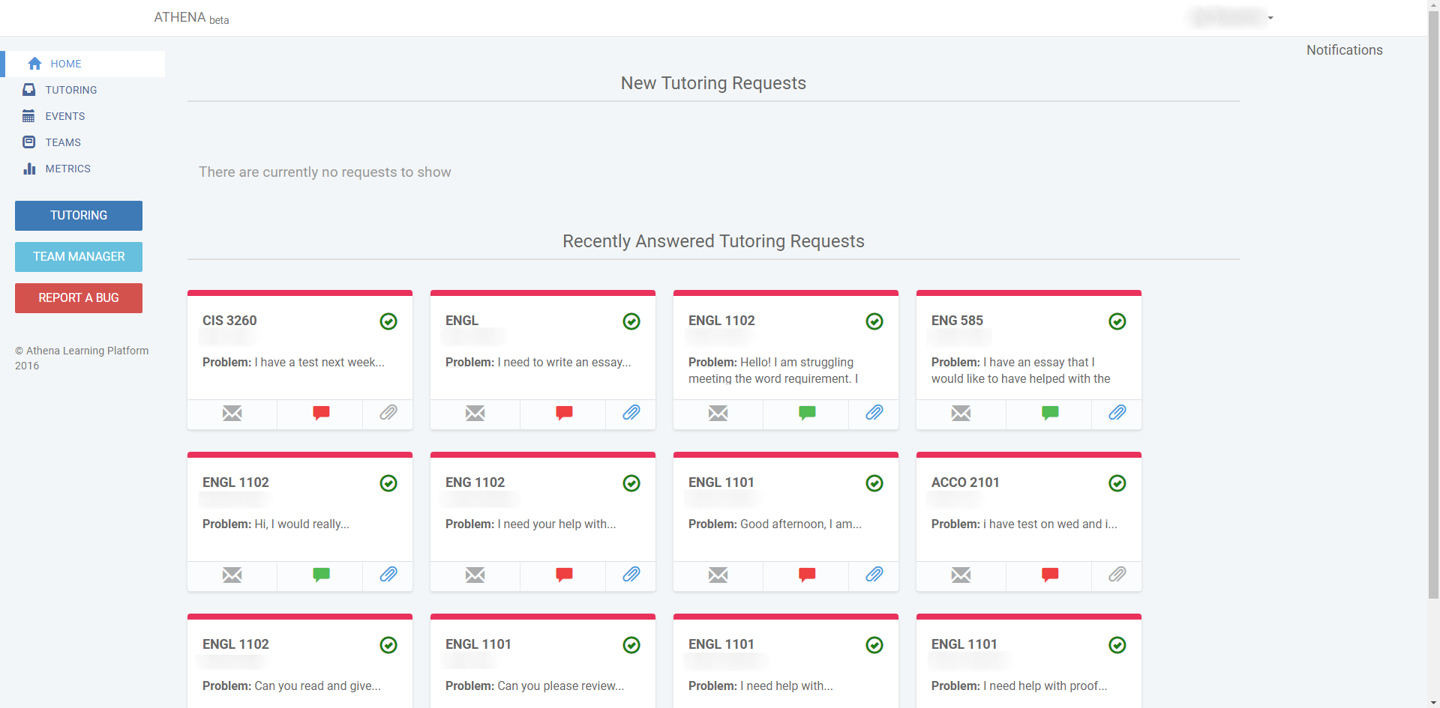

Slide 11
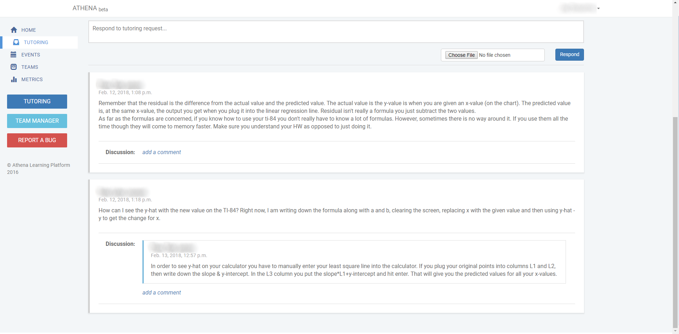

Slide 12
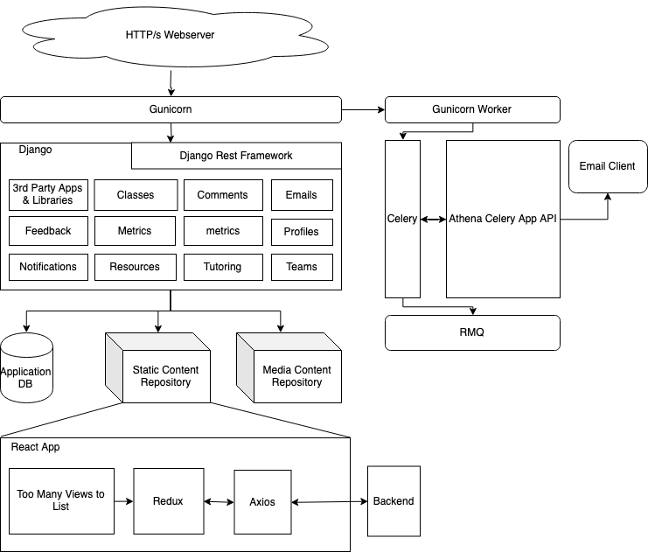
Questions:
Version control system?
How to host architecture?
How to store data?
User communication platform
Setting up mature CI/CD

Slide 13
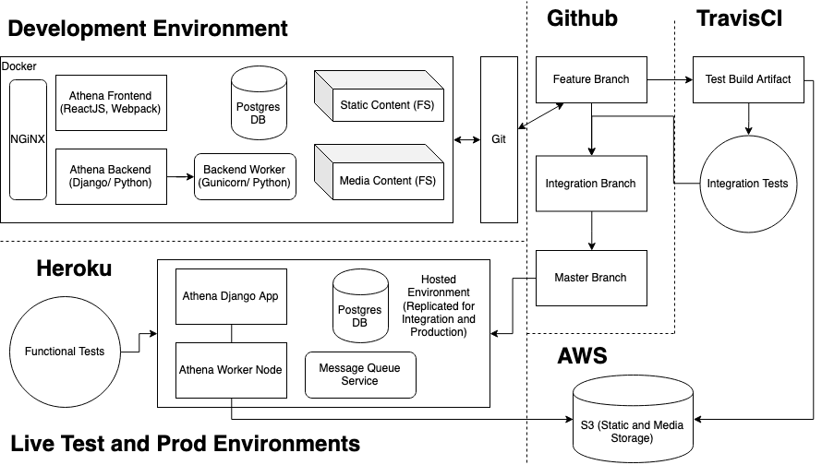

Slide 14
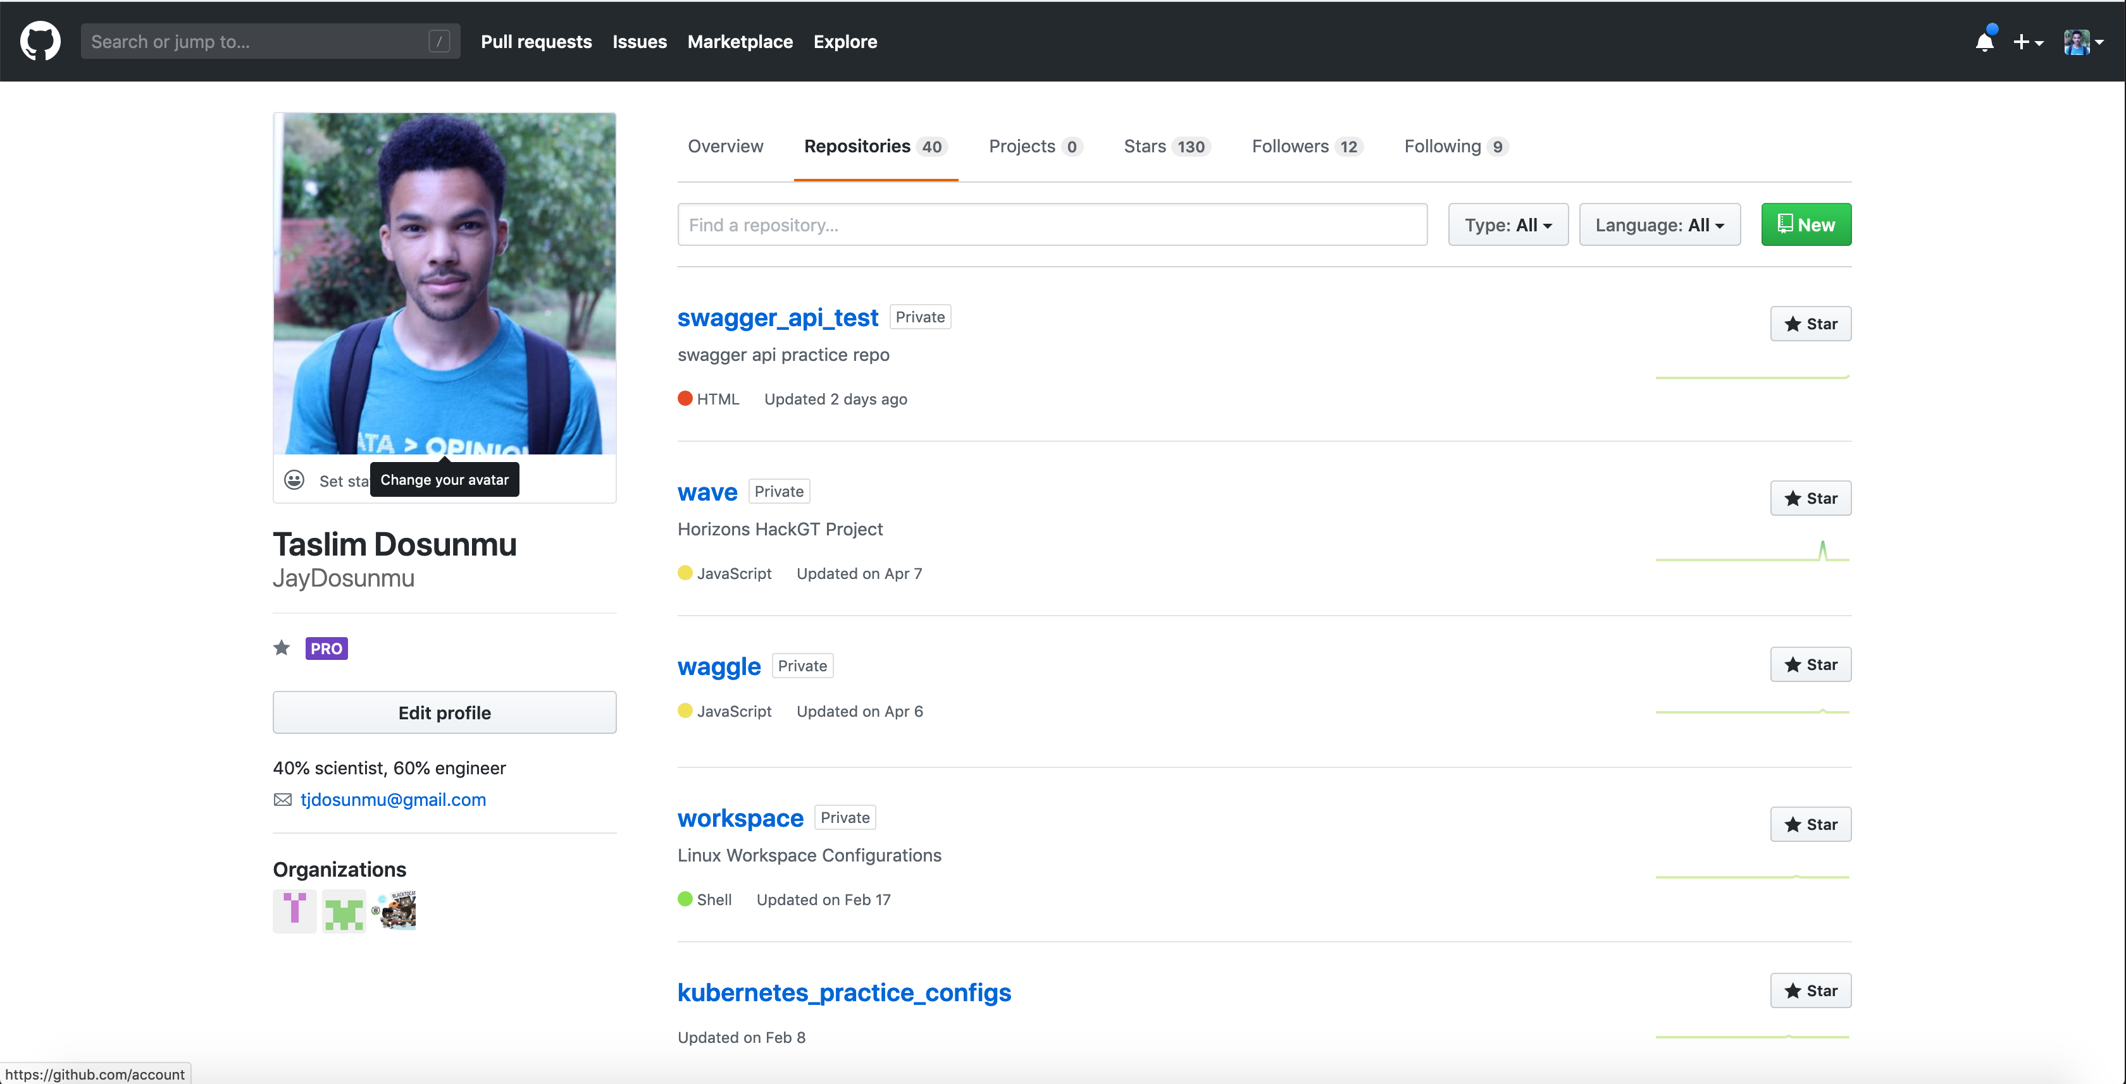

Slide 15
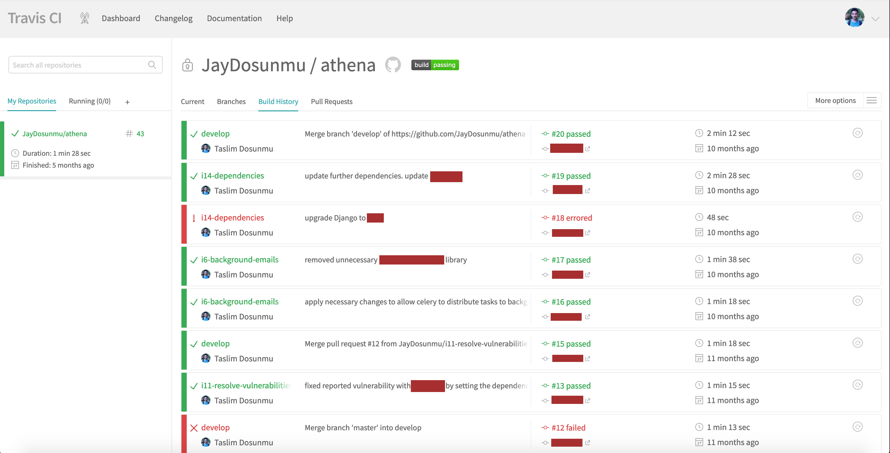

Slide 16
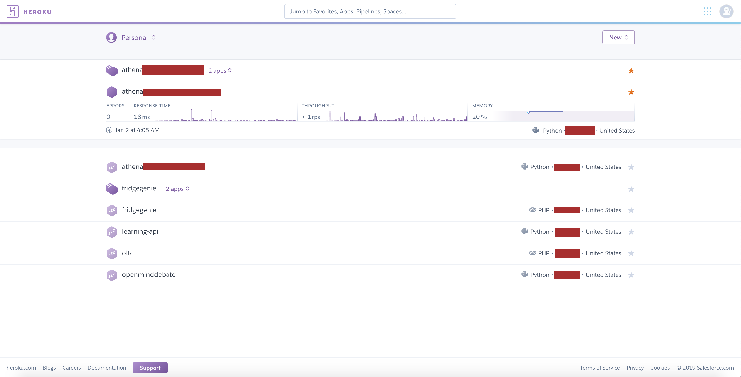

Slide 17
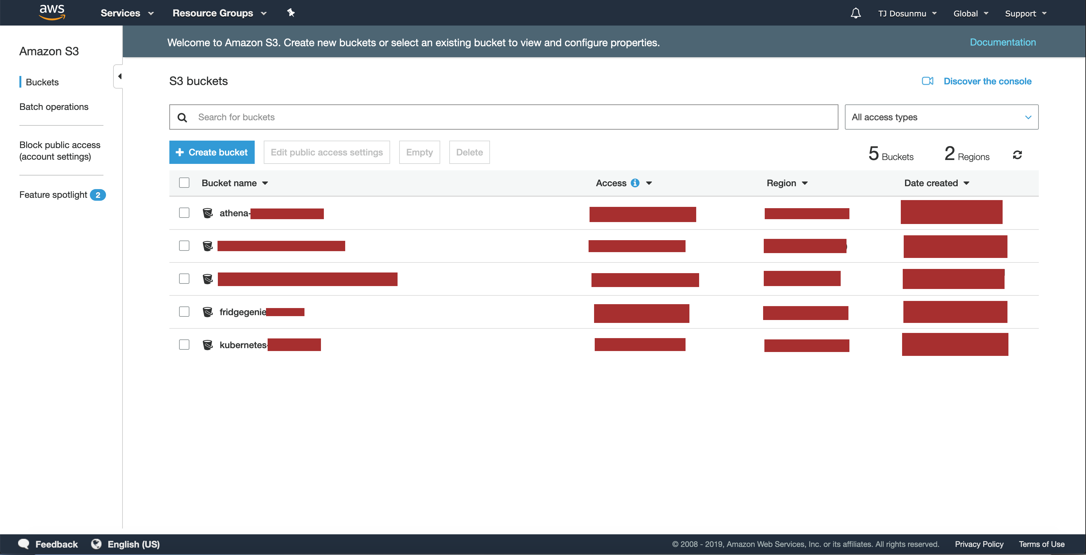

Slide 18
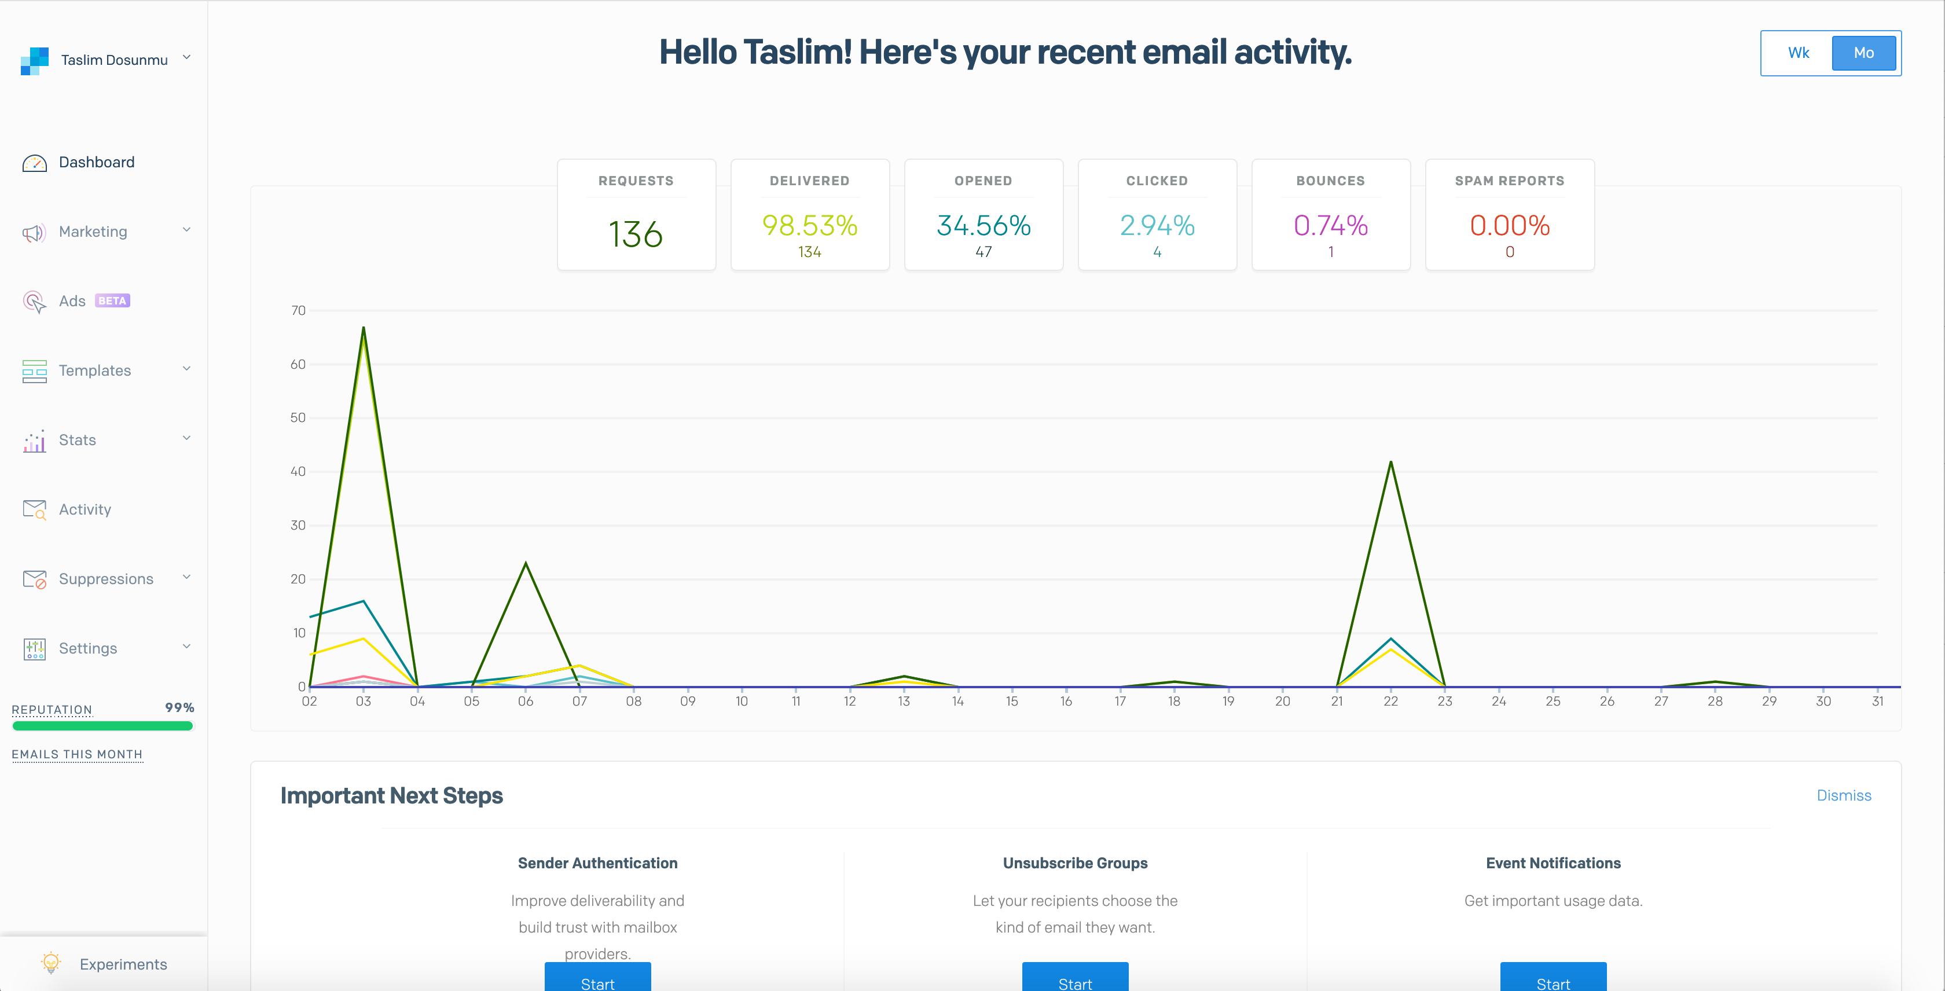

Slide 19
Be Open to Unexpected Opportunities
Was unable to get an internship Summer after Sophomore year
Met the SBnD AI team lead at PyData Meetup
Met John Britton at Github Universe
Attended a random SurveyMonkey recruiting event

Slide 20
Making the Most of Opportunities
Be Prepared for Anything Part II
Notes:
Dealing with Imposter Syndrome
Be open to unexpected opportunities again

Slide 21
Dealing With Imposter Syndrome
Your #1 obstacle is… you
It manifests when productivity is low
It manifests when facing something unknown

Slide 22
Be Open to Unexpected Opportunities Redux
All of your opportunities are given
Prove your value, and more opportunities are given
When facing new challenges, knowledge is power

Slide 23
Mentorship
Receiving and Giving Help
Notes:
Shout out to my mentors
Finding mentors
Becoming a mentor

Slide 24
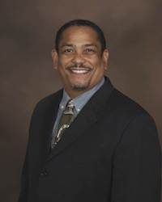
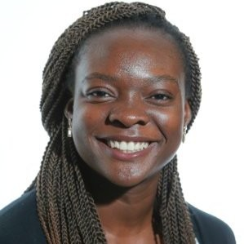
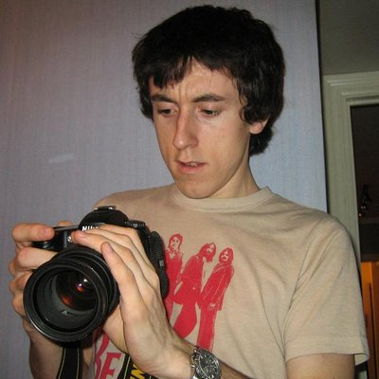
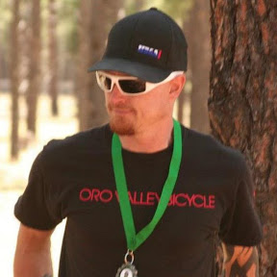
My Mentors
John Britton
Kit Plummer
Jessica Mong
Dr. Robert Joseph

Slide 25
Finding Mentors Everywhere
Be open
People want to help those who help themselves
Pay attention to people who look out for you

Slide 26
Becoming a Mentor
Everyone needs some kind of help
Everyone can offer some kind of help
Github Student Developer Pack is mentorship
Me presenting is mentorship
How will you mentor others?

Slide 27
Closing Statements

Slide 28
- Make Cool Things
- Make Things Better
- Do it Together

